Slide 1


Classroom Challenges Simulator
Presented by: reemy Halabi , Michael Trifonov
supervisor: Dr. Natali Levi
25-2-D-14

Slide 2


Addressing Teacher Challenges
Post-COVID Workload
Behavioral Diversity
Inadequate Training
Teachers face increased workloads and professional isolation, needing more support staff.
Teachers often face difficulty understanding and responding to complex student behaviors
Many teachers report insufficient training for classroom management and violence.

Slide 3
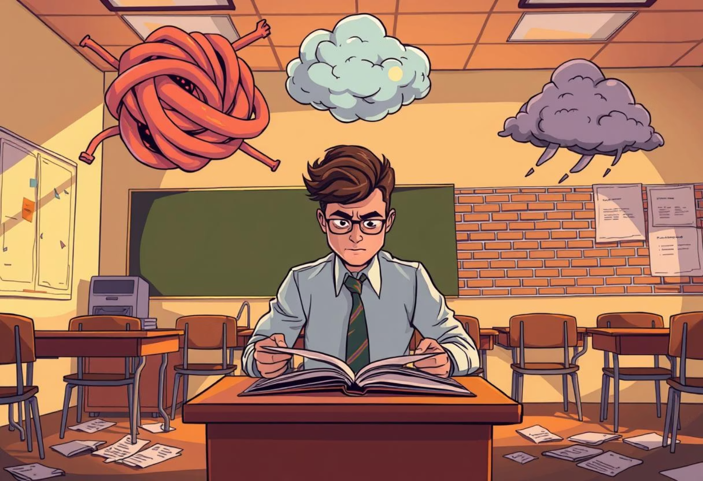
Tools Provided
Internships
Limited exposure to full spectrum of classroom challenges.
Theoretical Courses
Lack live, scenario-based practice for internalizing strategies.
Literature Guides
Lack interactive, real-time feedback for practical application.

Slide 4


Project Objective
Interactive simulation that equips future teachers with practical classroom management skills.

Slide 5



Alternatives
Ease of Use
Virtual Simulations
Mursion- Mixed-reality platform using human-in-the-loop avatars.
SimSchool- AI-driven virtual classroom where students react based on teaching inputs.
360° VR Classrooms-
high Pedagogical Intelligence
cost
Immersive pre-recorded classroom scenarios.
Allows observation and reflection.
High pedagogical intelligence
Low operational efficiency

Slide 6
CORE COMPONENTS FLOW
FSM & Probabilistic Models (Student Behavior Simulation)
Teacher Response Engine (Decision Logic)
Unity Engine
Cross-Platform Output
Analytics Module (Data Tracking & Feedback)
Gamification Layer (Points & Progress)

Slide 7


System Components
Student Behavior Simulation Engine
Generates realistic student behaviors using FSMs and Markov Chains using the Unity ML.
Teacher Response System
Provides interaction options with immediate and long-term consequences.
Scenario Management System
Manages pre-built and user-defined classroom scenarios with scripted events.
Performance Tracking and Analytics
Records decision history, classroom metrics, and provides data visualization.
Instructor Dashboard
Allows educators to assign scenarios, monitor progress, and provide feedback.

Slide 8

Emotional State Parameters
Each Student Agent maintains an emotion vector shaping its decision policy. Values range from 1 to 10, updated continuously.
Parameter
Increase Triggers
Decrease / Decay
Behavioral Influence
Happiness
Teacher acknowledges, Peer praise
Time since positive event, Negative feedback
Biases towards listening, engaged participation, helping peers.
Sadness
Teacher ignores, Wrong answer
Successful contribution, Teacher encouragement
Lowers talk frequency, can lead to withdrawn behavior.
Frustration
Ignored attempts to speak, Noise
Successful turn-taking, Clear guidance
Drives transitions to disruptive behavior, feeds into anger.
Boredom
Long inactivity, Topic mismatch
New task, Physical break
Raises off-task chance (doodling, phone), triggers yawning.
Angry
Teacher cuts off, Invalidation
Teacher apology, Restorative conversation
Unlocks confront action, doubles penalty for negative feedback.

Slide 9

ask question to all class
student : sam
adress specific student
student : bob
Happiness:<2/5>
Sadness:<2/5>
Frustration:<1/5>
Boredom:<4/5>
Angry:<1/5>
Happiness:<2/5>
Sadness:<2/5>
Frustration:<1/5>
Boredom:<4/5>
Angry:<4/5>
time out

Slide 10

ask question to all class
student : sam
student : bob
Happiness:<2/5>
Sadness:<2/5>
Frustration:<1/5>
Boredom:<4/5>
Angry:<1/5>
Happiness:<2/5>
Sadness:<2/5>
Frustration:<1/5>
Boredom:<4/5>
Angry:<4/5>

Slide 11
sam answers the question write
praise
acknowledge
peer praise
student : sam
student : bob
Happiness:<4/5>
Sadness:<1/5>
Frustration:<1/5>
Boredom:<2/5>
Angry:<0/5>
Give a Bonus Role or Responsibility
Happiness:<1/5>
Sadness:<2/5>
Frustration:<1/5>
Boredom:<4/5>
Angry:<5/5>
Continue the Flow

Slide 12
i hate this class #@!&!!!!
student : sam
student : bob
Happiness:<4/5>
Sadness:<2/5>
Frustration:<1/5>
Boredom:<2/5>
Angry:<0/5>
Happiness:<2/5>
Sadness:<2/5>
Frustration:<1/5>
Boredom:<4.5/5>
Angry:<5/5>

Slide 13
acknowledge
student : sam
student : bob
Happiness:<3/5>
Sadness:<2/5>
Frustration:<1/5>
Boredom:<2/5>
Angry:<0/5>
send to princable
Happiness:<2/5>
Sadness:<2/5>
Frustration:<1/5>
Boredom:<4.5/5>
Angry:<5/5>
Continue the Flow
-1 happines
+1 frustration
-1 happines
-1 happines

Slide 14





Understanding Student Behavior
Disruptive Behavior
Reduces academic time and lowers grades. Prevention through rules and routines is key.
Engaging Students
Collaborative discussion and argumentation increase knowledge and reasoning skills.
Talkative Students
Can enhance discussion but needs management to avoid disruptions. Use structured roles.
Distracted Students
Shrinks engagement time. Active, role-based participation and clear routines help.

Slide 15

Gamification Impact On Teacher Education
Interactive and effective.
Boost motivation.
Enhance learning outcomes.
Natural improvement.
Encourages practice.

Slide 16
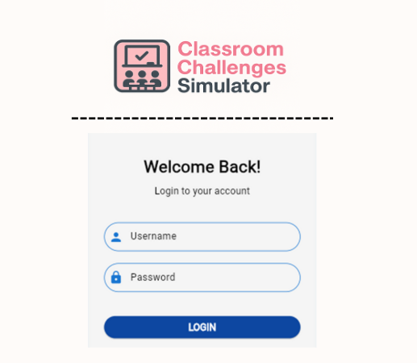
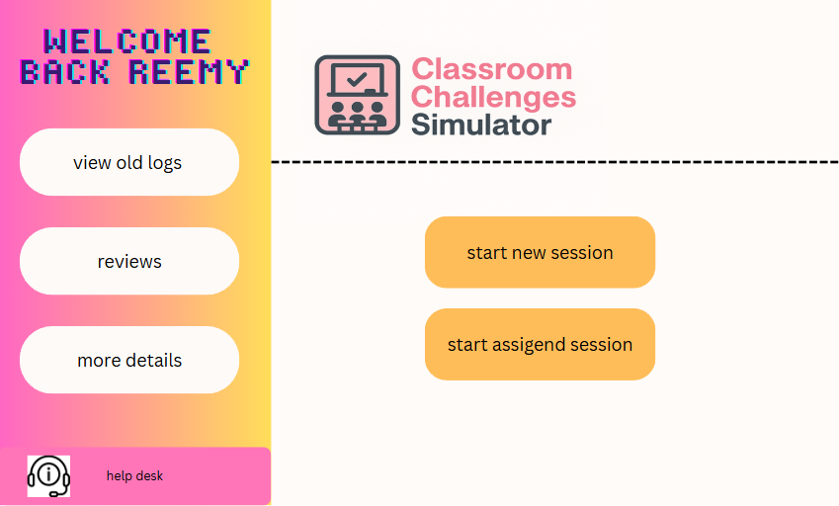
Teacher main screen

Slide 17
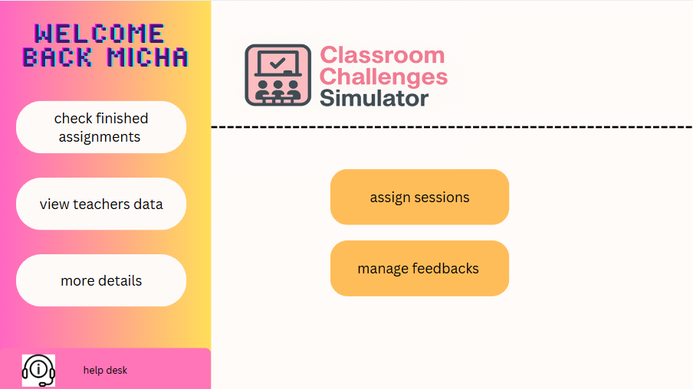
Instructor main screen

Slide 18






Technology Overview

Slide 19
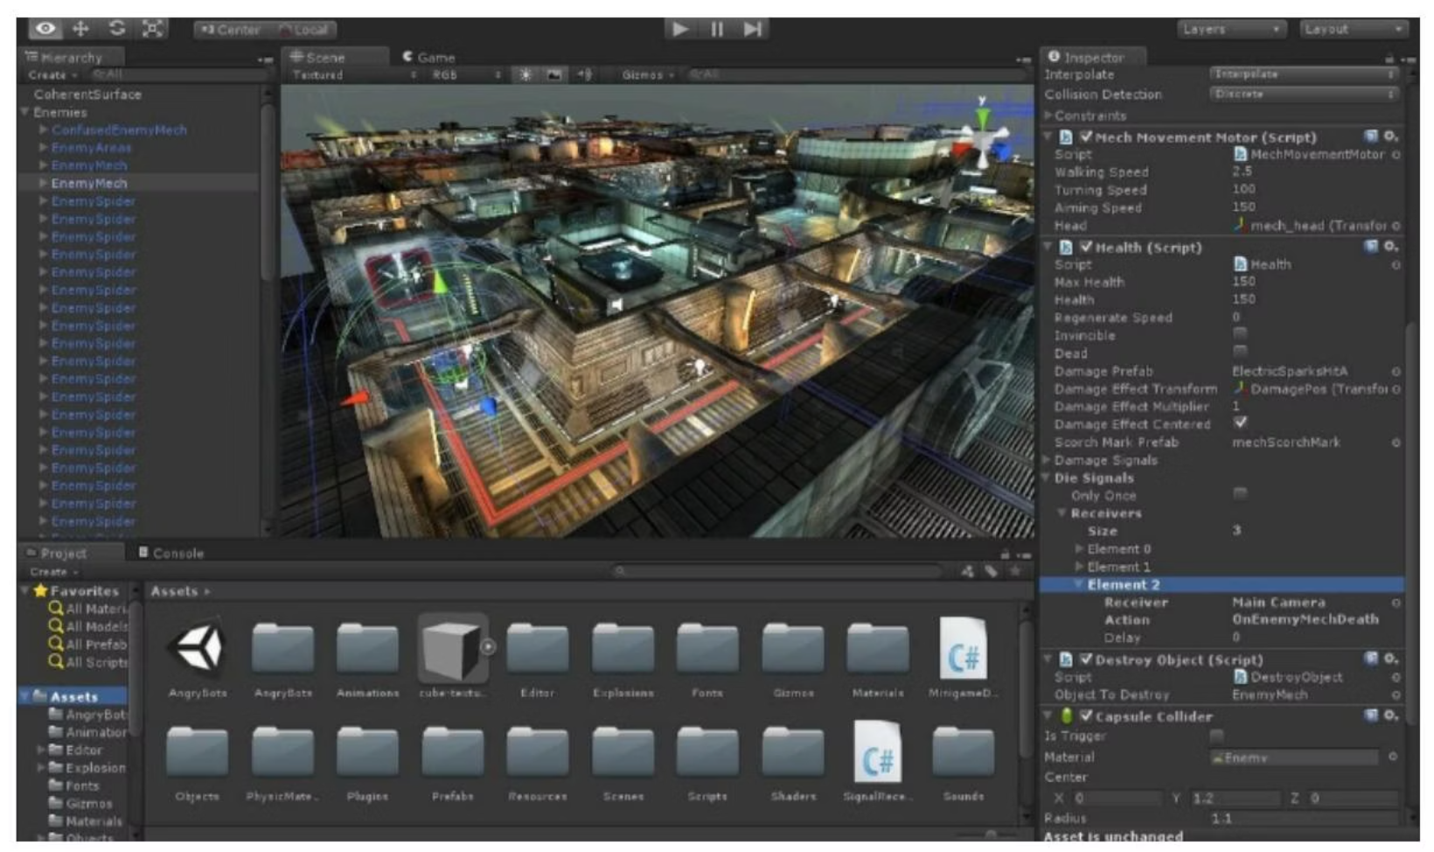
Unity Engine Advantages
Cross-Platform
Deployable on Windows, macOS, iOS, Android, and VR devices.
C# Scripting
Enables clean, maintainable codebase for simulation mechanics.
Unity provides a comprehensive suite of development tools for rapid prototyping.
Physics Engine
Supports realistic modeling of object interactions and dynamics.

Slide 20
Bridging Theory and Practice
Accessible, Affordable, and Scalable
Simulates Emotional and Behavioral Complexity
Provides Measurable Growth Through Feedback

Slide 21
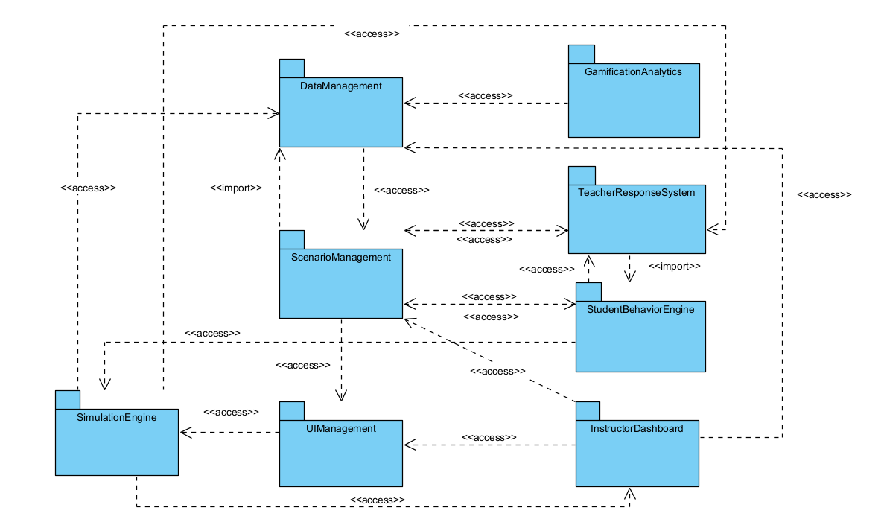
Package Diagram

Slide 22
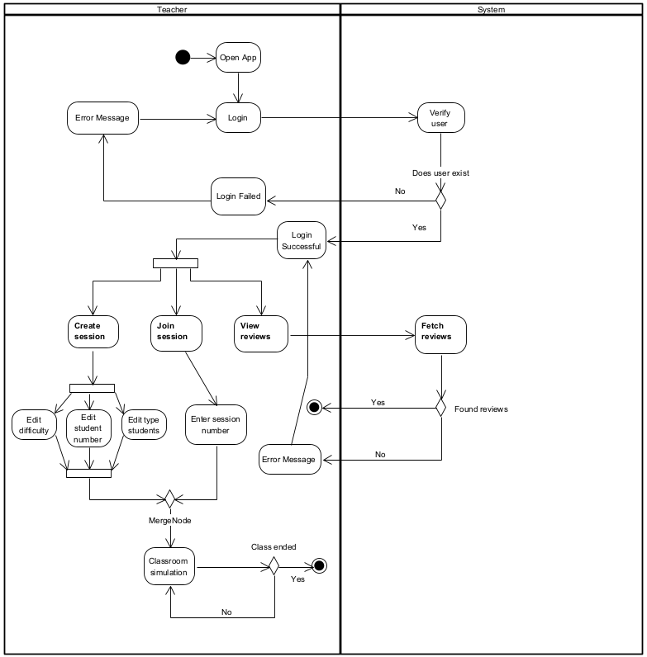
Activity Diagram

Slide 23
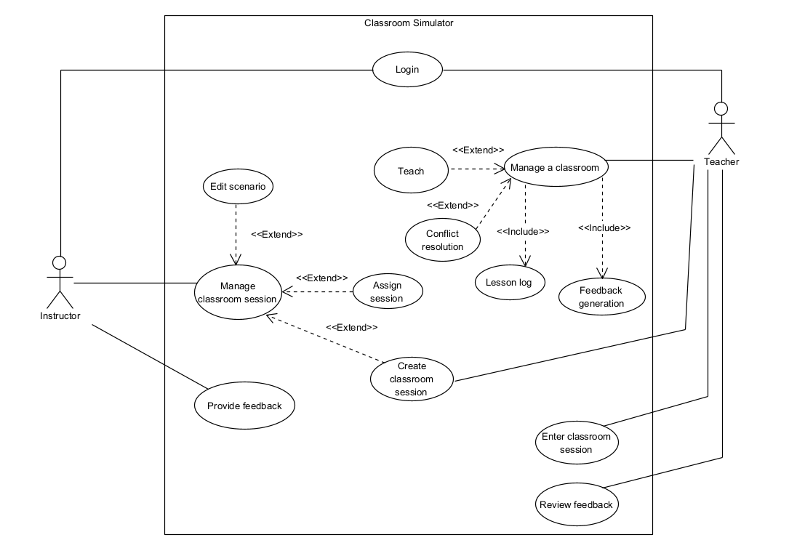
Use Case Diagram

Slide 24
Classroom Challenges Simulator – Testing Plan
Test | Module | Tested Function | Expected Result
1 | Main Menu & Scenario Loader | Scenario loading and main menu navigation | User selects and loads scenarios smoothly
2 | Avatar Behavior Engine | Simulated student responses (FSM, Markov) | Students respond naturally to triggers
3 | Teacher Response Actions | Prompts, seating changes, etc. | Teacher choices affect class dynamics
4 | Student Emotional Feedback | Emotional state updates & visual reactions | Emotions change based on teacher input
5 | Scenario Progression System | Branching logic and event triggers | Events proceed logically per script rules
6 | Analytics and Logs | Action tracking and session replay | Logs match user actions with no loss
7 | Gamification & Rewards | Points, badges, and level display | Gamified elements appear and update correctly
8 | Usability and UI Flow | Navigation clarity and action placement | UI is intuitive for trainees to navigate
9 | Performance and Frame Rate | Responsiveness and load handling | App maintains ≥60 FPS, no major delays
10 | Cross-Platform Deployment | Deployment on Windows, Android, iOS | App builds and runs correctly on all platforms

Slide 25
Teacher Interview Insights
Key Challenges
Disruptive students, adapting plans, engaging families.
Training Gaps
Limited, insufficient training; lack of real-life practice.
Emotional Intelligence
Crucial for identifying student distress and managing stress.
Simulation Interest
Strong interest in tools for realistic scenarios and feedback.

Slide 26
Thank you

